Slide 1
Introduction Hour
Unique & Connected

Slide 2
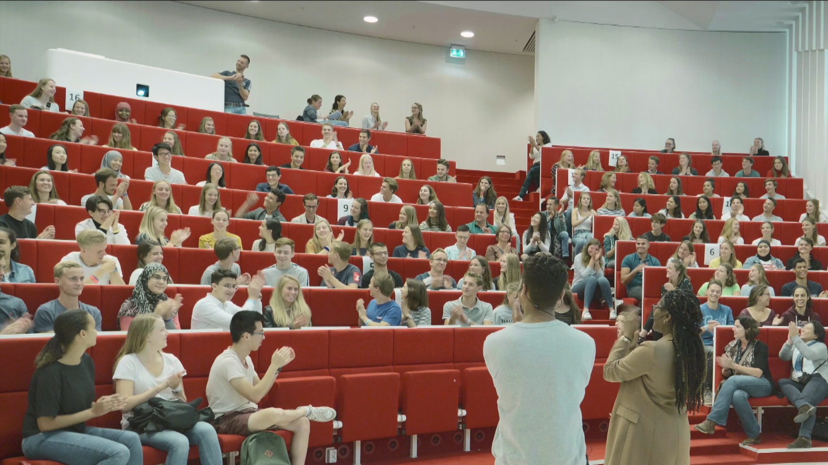

Welcome!
Theme: Unique & Connected
Student Introductions
Notes:
2nd/3rd year students welcome the group, introduce themselves briefly (name + year), let the students know how they are feeling (excited/tense...) and tell them what the purpose of the hour (get a good start on getting to know your fellow students from your class) is.
NB. It is important to let the 2nd/3rd year students lead the session but make sure to stay involved as the teacher.

Slide 3

Teacher Introduction
Notes:
Teacher(s) introduce themselves briefly (name, function, story).
(it is important to express vulnerability and overcoming of challenges to the students in this introduction)
Set the tone for interaction by making clear how students can address them and staff members in general. Make explicit if titles such as professor/dr. or first names should be used and if in Dutch which addressing pronouns (je/jij/u) should be used.

Slide 4
Let’s meet….. in pairs
Who are you?
What do you like about Rotterdam?
What stuck out to you in this study so far (Introduction week included)?
What expectations do you have for this lesson?
How did you get through the quarantine?
What are you most looking forward to today?
What are you most looking forward to in general?
(choose two questions that you would like to answer)
Notes:
Let the students introduce themselves to each other in pairs using some of the questions provided in the accompanying PowerPoint (p.4). They do not have to answer all questions just as many as time allows.
Walk around the room and support the conversations where needed, keep in mind that some students may find having an authority figure in the conversation intimidating.

Slide 5
Mentimeter
Mentimeter.com
Code:
Notes:
This slide can be used to add a question for mentimeter where you can ask everyone anonymously a question and generate a word cloud.
Possible Question: “How do you feel right now about the start of your bachelor?”
Make sure to tell them to answer using one word only
NB. Be sure to set this up before you start the session. You can try testing it with the 2nd/3rd year students who will be helping you with the session.
In the case that someone posts an inappropriate/sexist/racist answer in the word cloud you can use this as an opportunity to point out that this behavior is not what you are striving for in this classroom. You do not need to shy away from these moments rather turn them around.

Slide 6

You’re not the only one ...
Personal story from the 2nd/3rd year students.
Notes:
This is the where the senior students who are helping run the session can tell personal stories about their vulnerabilities related to "doing something for the first time, being in a new environment, and/or not feeling at ease in a group" is central.
Make sure the stories are kept short (± 2 min) and have a clear message. The personal development resulting from the challenge should be emphasized.

Slide 7
Individually: answer these questions
Name a moment in your life similar to today: you were there for the first time....(e.g. in elementary school, high school, first job)
How did you feel then?
Did you do anything to influence your experience?
How do you look back on that day?
What did you miss on that day, or what would you have liked to see or experience?
Notes:
Change to the slide on the PowerPoint with the relevant questions (p.7). Ask the students to take 2mins to answer the questions for themselves.

Slide 8

Sharing of Experiences
Tell your answers to your neighbor.
Try to really listen to the other person (listening to understand not react)
You may only ask two questions
Notes:
Ask the students to take 2mins to answer the questions for themselves. After this they should ask their neighbor two of the questions on the slide and listen carefully (listening to understand not to react). If they find the story interesting they can also ask if they could share it with the room. Give each student 3mins to speak and clearly indicate when to swap.
Walk through the room and support the conversation if necessary. If you hear a story that you think could be valuable for the whole group to hear, ask if you could be allowed to share it with the room (+/- anonymized). You can also encourage students to tell it to the audience themselves.
NB. This can be accompanied by some calm background music if necessary.

Slide 9
Plenary recap of experiences
Who would like to share an experience with the audience?
Eye openers, heartbreakers, memory moments
Notes:
This is the time to give space for the students to share each other's stories (with permission of the other students).
Try to link stories together; by doing so emphasize that everyone feels this way from time to time. Link it to your own experience if necessary. Make sure that the recalling of answers is done in a safe way! Encourage the students to support one another.

Slide 10
Networks of Support
Notes:
Use this slide to introduce your class/faculty.
Explicitly mention:
What kind of peer support is available, such as mentor programs.
What the role of study advisor is.
Who the study advisors are and how they can be reached (include photographs and email addresses/office hours).
What kind of support professors and lecturers can provide.
The student well-being program.
Students with a functional impairment team.

Slide 11
Thank you very much and have fun!
Notes:
Finish the session by thanking the students for their time and adding any necessary closing remarks.
Remain available for questions, or conduct a Q&A based on the feeling in the room.

