Slide 1
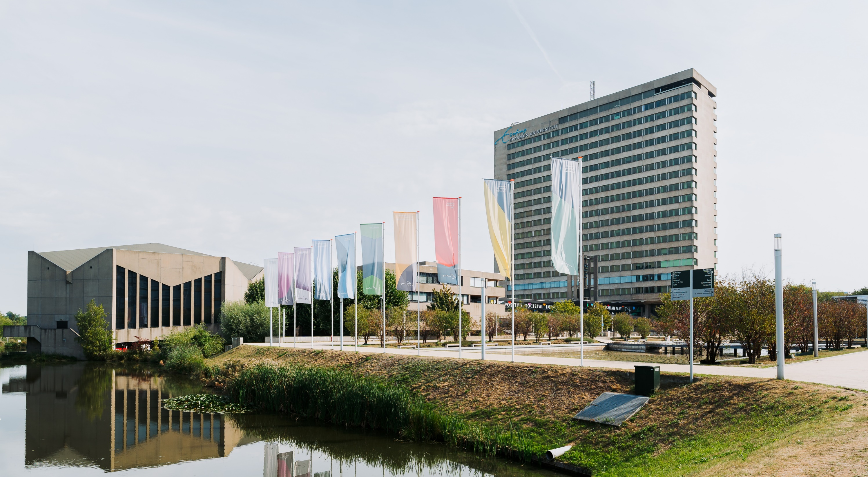
Building impact pathways
Using Theory of Change
[Name]
Evaluating Societal Impact
06 October 2025

Slide 2
Information
Journey of Progress is developed by the Evaluating Societal Impact team at Erasmus University Rotterdam (EUR).
While the game is self-explanatory, you may use this slide deck when delivering a workshop using the Journey of Progress game - for example when learning about and constructing a Theories of Change, defining joint goals and ambitions, or reflecting on the societal impact of a group, project or initiative.
This deck is only a starting point - Feel free to edit the slides to fit your situation and context.
Evaluating Societal Impact (2024). Journey of Progress – Theory of Change card game. Erasmus University Rotterdam (EUR). Physical object. https://doi.org/10.25397/eur.25311478
Notes:
This slide is hidden.

Slide 3
[ NAME ]
Information about the moderator, project, etc.
Notes:
This slide is hidden.

Slide 4
Goal of today
Get familiar with Theory of Change
Build a (simplified) ToC
Discuss questions
Erasmus University Rotterdam | Evaluating Societal Impact
06 October 2025 | 4

Slide 5
Theory of Change (ToC) is a method
for describing your theory about how and why change is supposed to happen.
Erasmus University Rotterdam | Evaluating Societal Impact
06 October 2025 | 5

Slide 6

Where do you see Theories of Change?
Mission statements
Strategy formulations
Grant applications
...
Drucker (1954);
Weiss (1995);
Grantcraft (2006);
Mayne (2017);
Belcher et.al. (2020)

Slide 7
Where do you see Theories of Change?
Mission statements
Strategy formulations
Grant applications
...
Belcher et.al. (2020)
Brest (2010)
Grantcraft (2006)
Weiss (1995)
Drucker (1954)
Erasmus University Rotterdam | Evaluating Societal Impact
06 October 2025 | 7

Slide 8
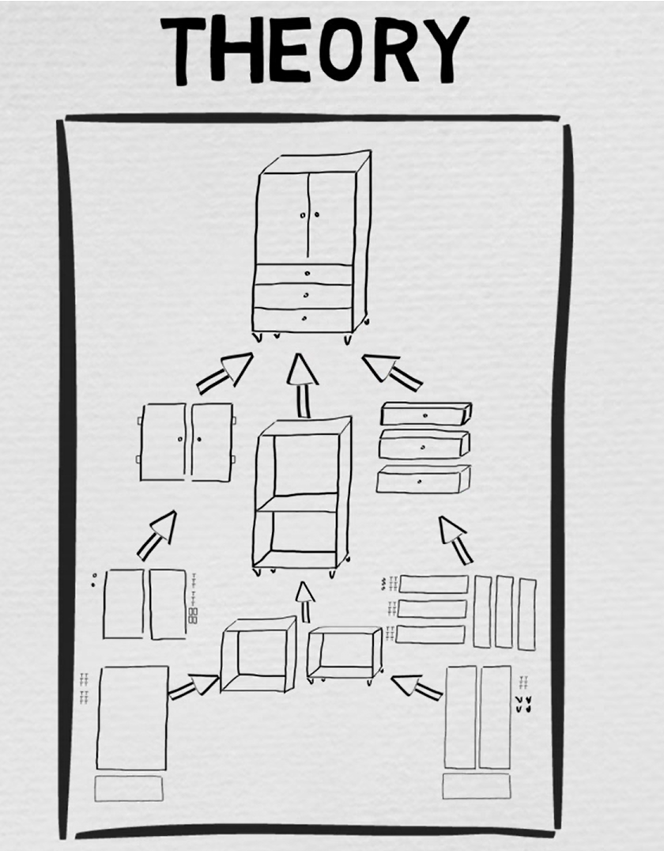
What is a ‘theory’?
Your Theory of Change
illustrates how actors, activities and outcomes relate to each other within your context and outlines the steps you can take to achieve a bigger goal.
Theory of Change Explainer – Al Onkka
https://youtu.be/BJDN0cpxJv4
Erasmus University Rotterdam | Evaluating Societal Impact
06 October 2025 | 8

Slide 9
Why would you build a ToC?
Planning
Discovery
Collaboration
Evaluation
Find out
what to do
Reveal
biases and
blind spots
Create
shared
understanding
Determine
the necessary evidence
for assessment
Erasmus University Rotterdam | Evaluating Societal Impact
06 October 2025 | 9
Notes:
It helps you identify the necessary actions to influence change. Your ToC shows the causal connections between the now and the future, identifying different pathways that may lead there. Think of it more like as a compass instead of a map.
Broaden by perspective by discovering blind spots and biases, uncovering the assumptions you might have, helping to define possible stakeholders involved in your context.
Create shared understanding and alignment within your team, with your stakeholders
Helps you find pointers on how to assess success along the way - It is your starting point for monitoring and evaluation. By attaching indicators to the different elements that you believe will provide meaningful information, you can assess and learn from your progress and communicate about it.

Slide 10
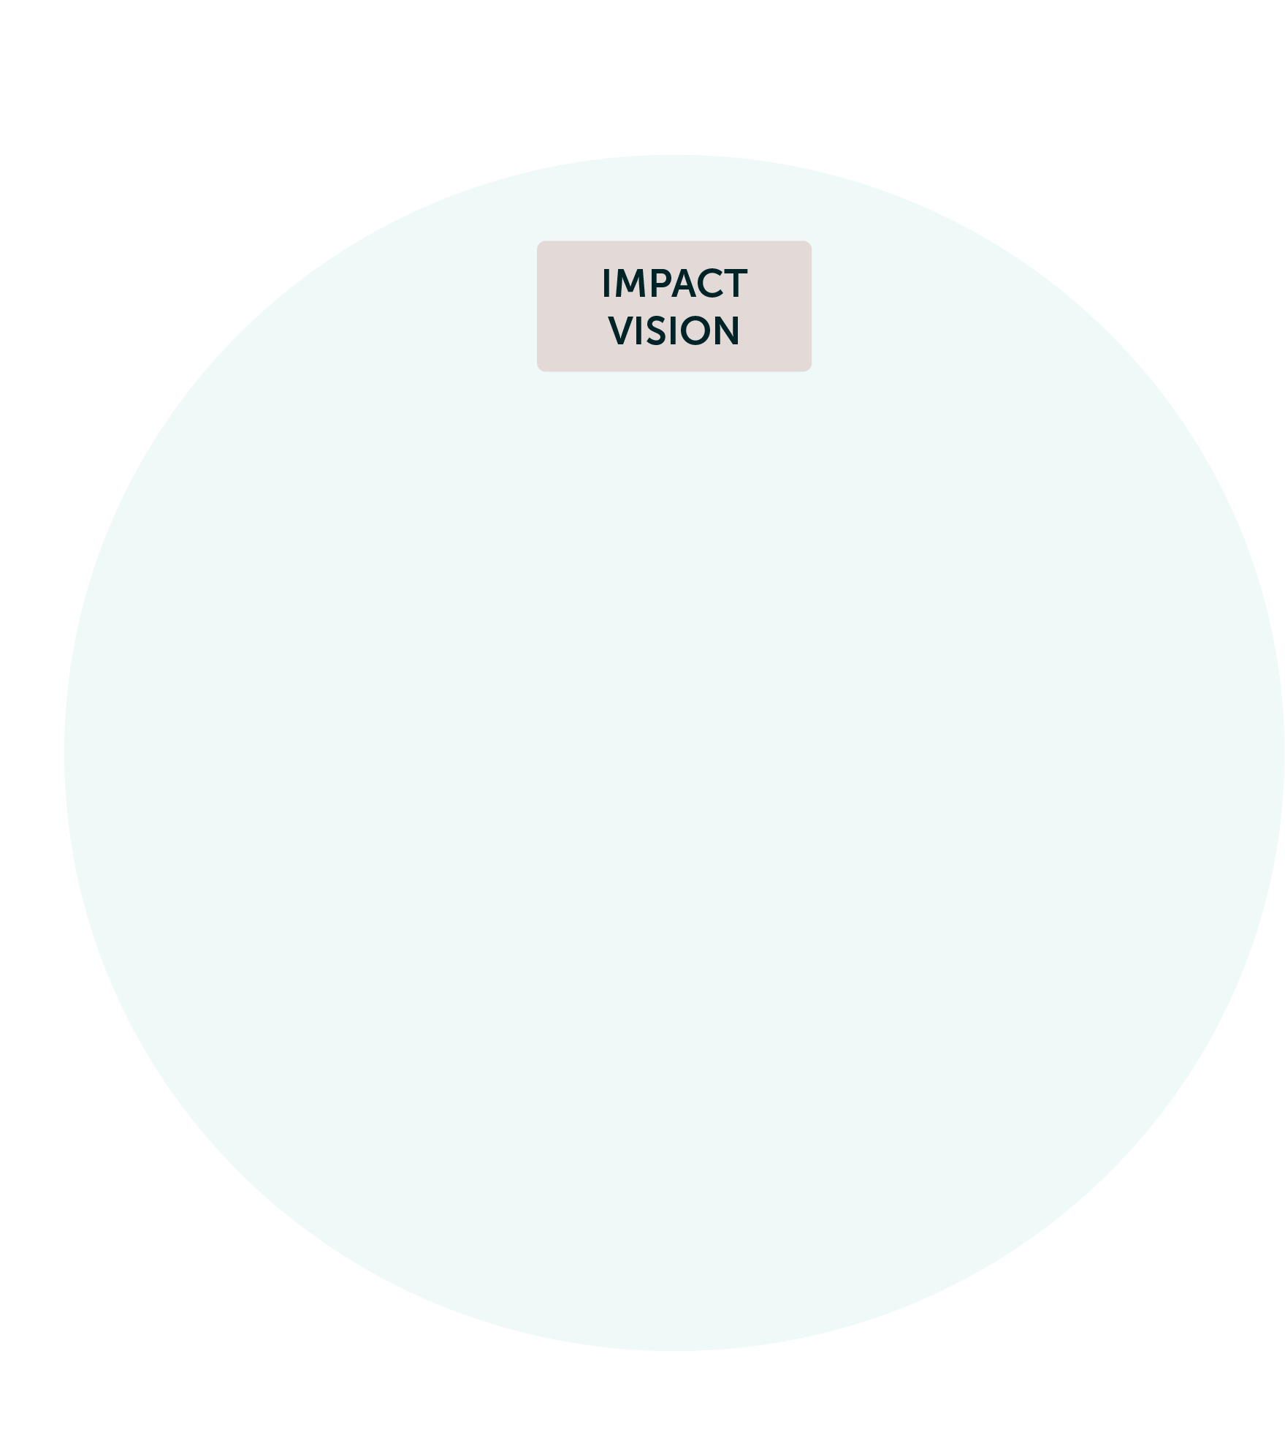
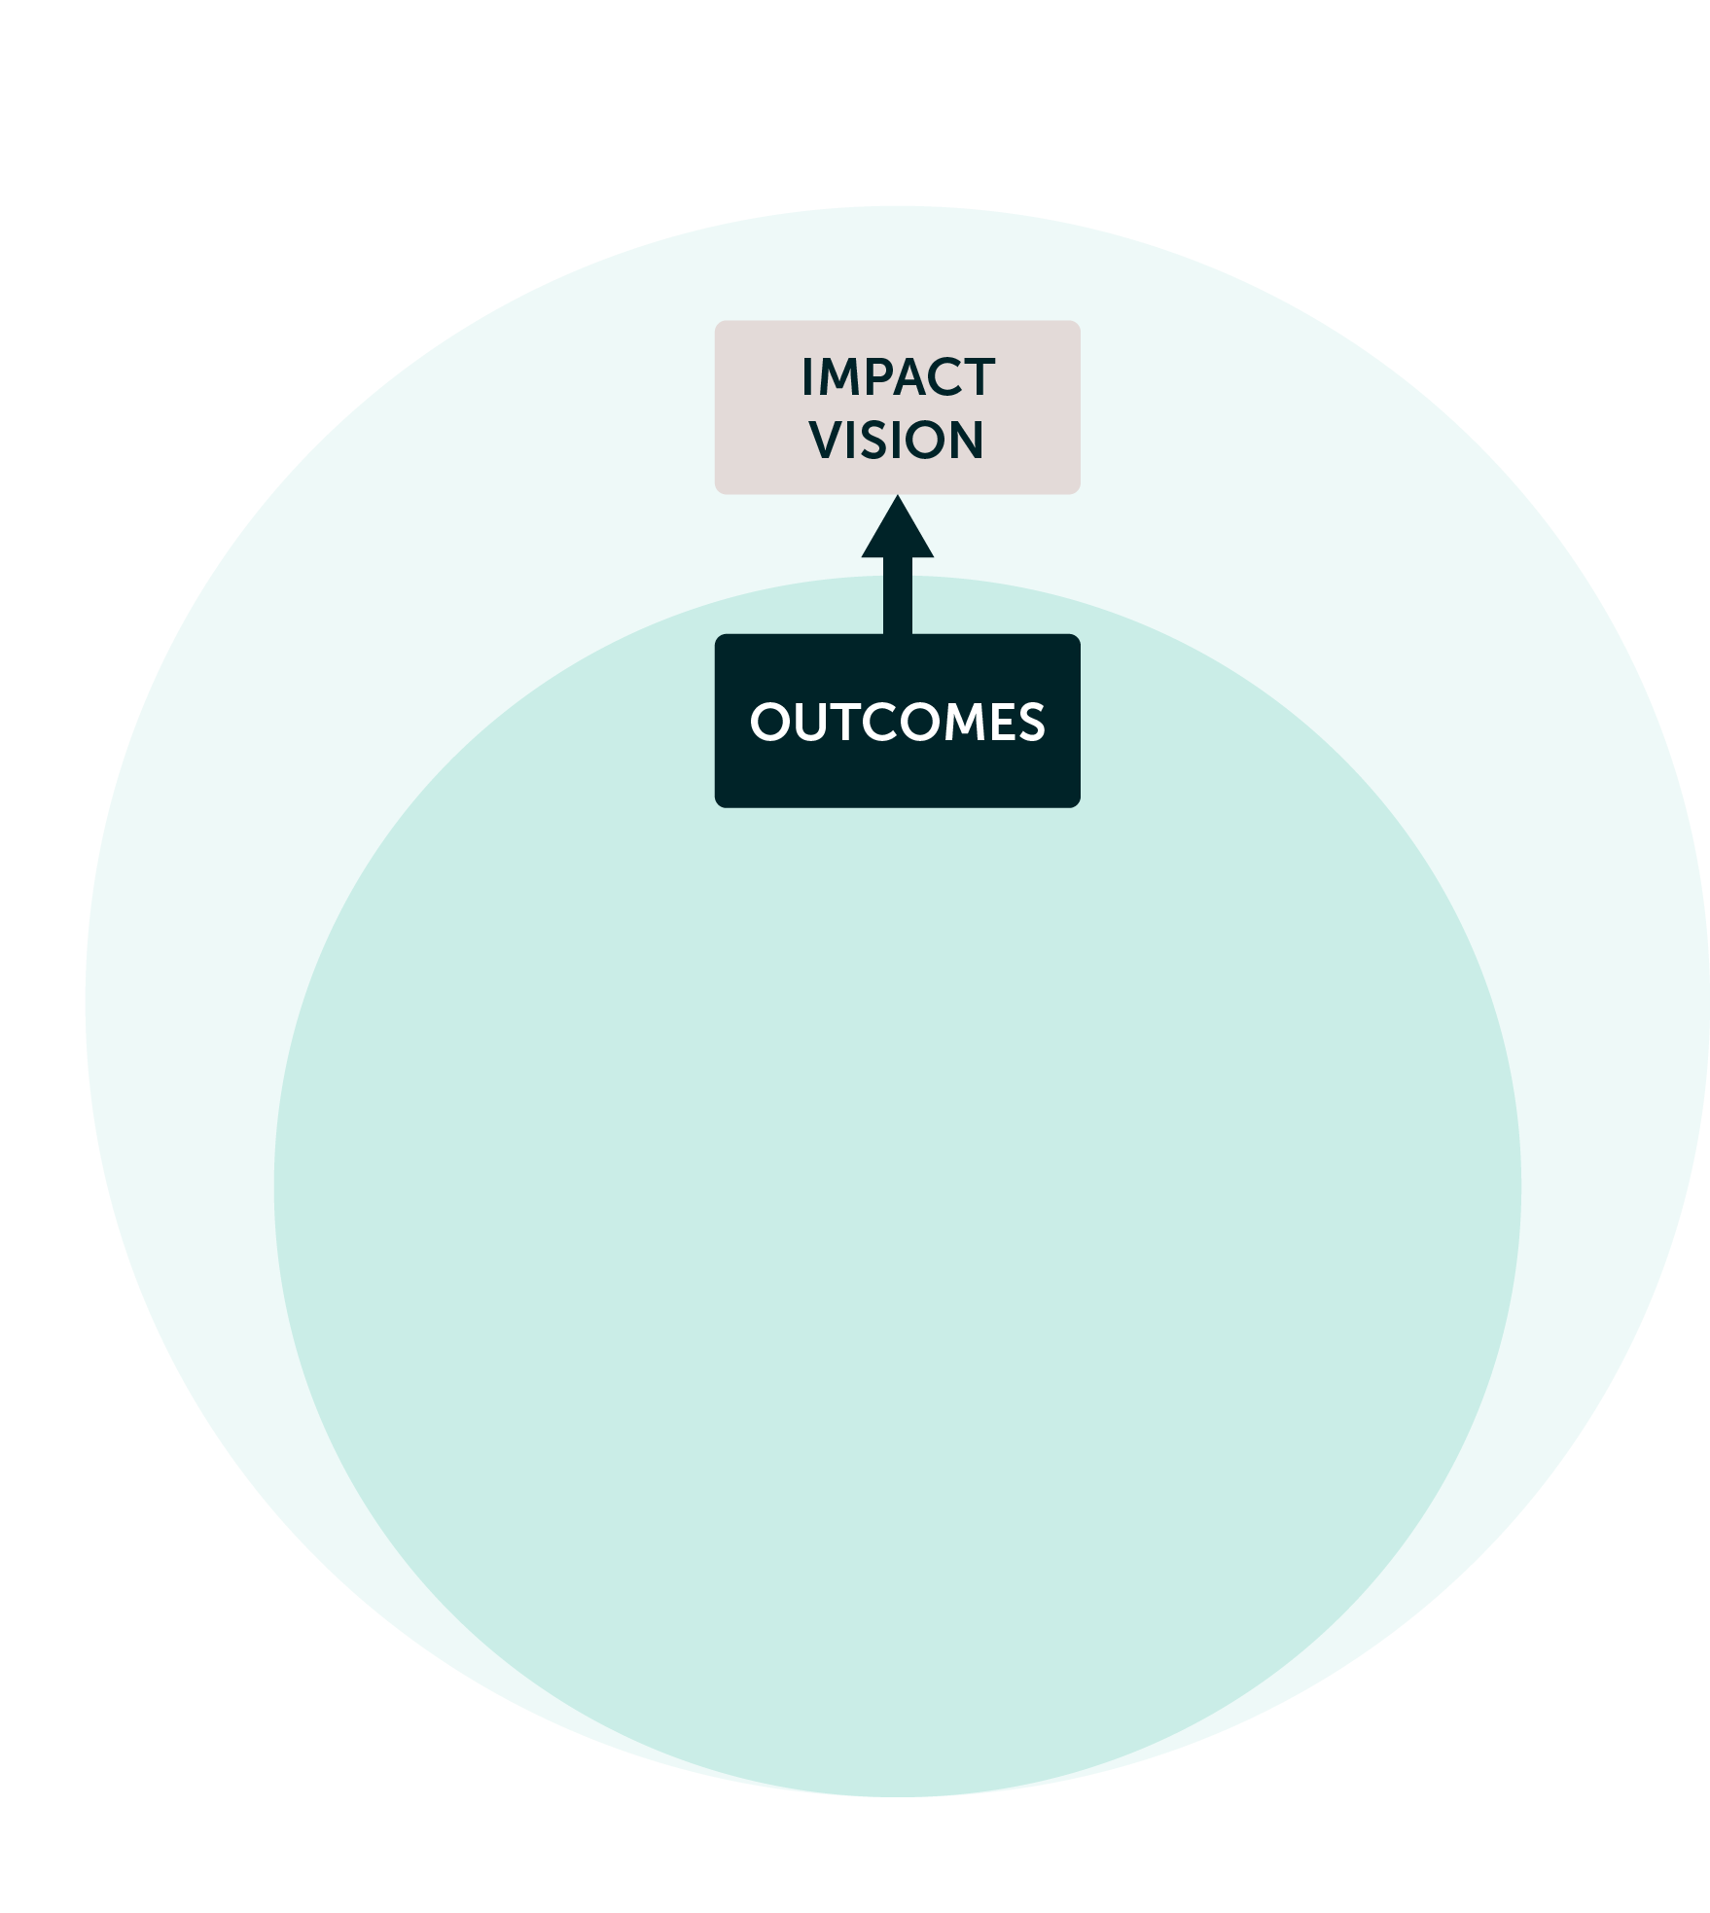
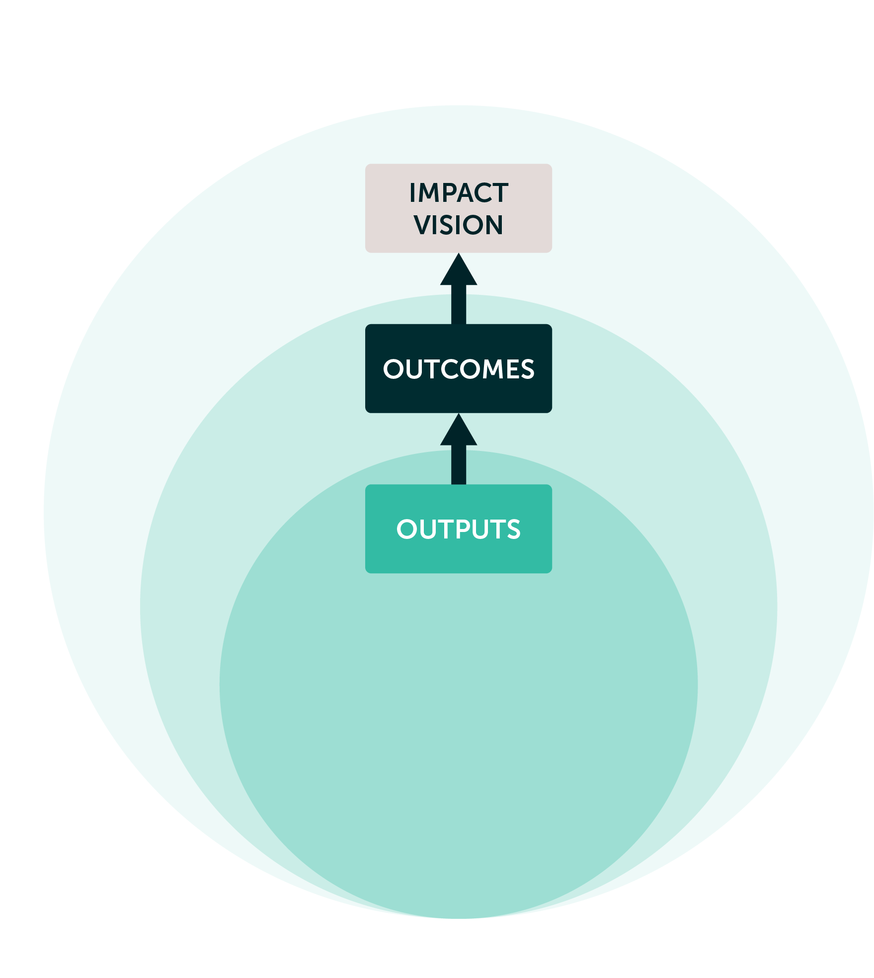
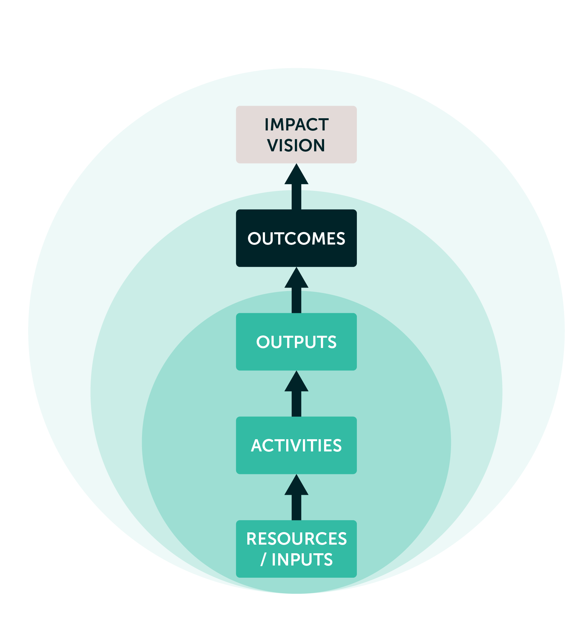

How do you build a Theory of Change?
Our family enjoys the benefits of a healthy lifestyle
Sphere of Interest
Family members eat healthy
Sphere of Influence
Four bowls
of soup for all family members to eat
Sphere of Control
I cook soup for dinner, using fresh vegetables
Erasmus University Rotterdam | Evaluating Societal Impact
06 October 2025 | 10
Notes:
It starts with having a mission, or vision - It describes improved conditions that you hope to see in the future.
To realise this mission, certain changes need to happen. These are the outcomes that need to be achieved, things you might or might not be able to influence.
Identify what can help to realise those outcomes – these are outputs what you can probably realise through specific activities.

Slide 11
How does a Theory look like?
Global Fund for Children
The Global Partnership for Sustainable Development Data
https://globalfundforchildren.org/wp-content/uploads/2019/07/GFC-Theory-of-Change-Map.pdf
https://www.data4sdgs.org/sites/default/files/services_files/GPSDD%20Theory%20of%20Change.pdf
Erasmus University Rotterdam | Evaluating Societal Impact
06 October 2025 | 11

Slide 12
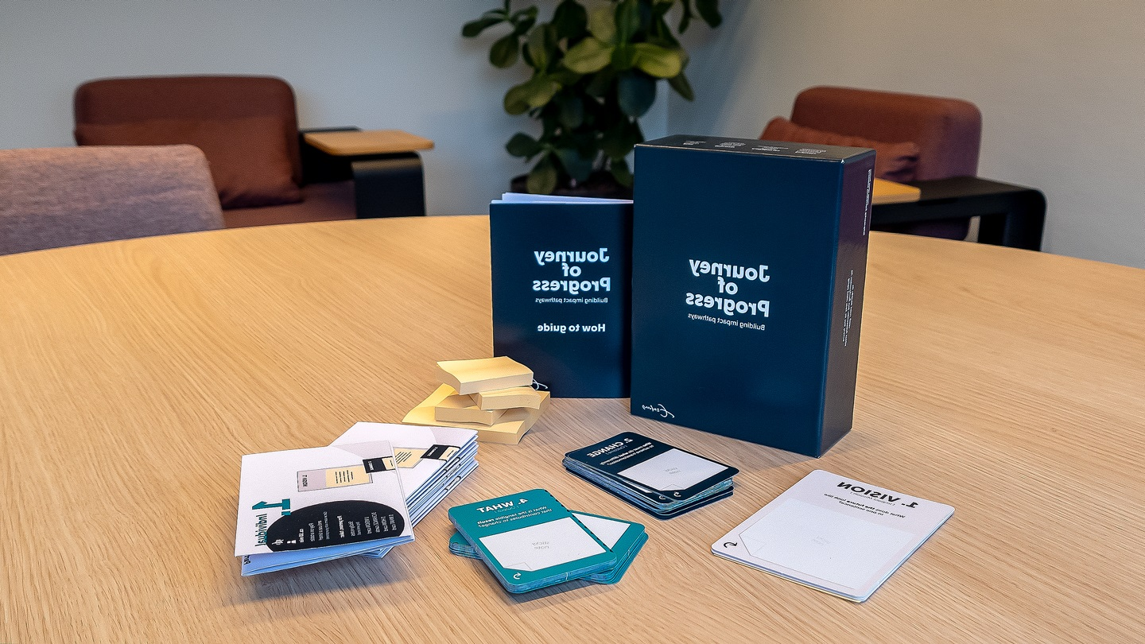
The game
Journey of Progress
A tool to think collaboratively about complex processes of change.
DISCLAIMER:
This is only the beginning of a ToC!
Erasmus University Rotterdam | Evaluating Societal Impact
06 October 2025 | 12

Slide 13

Individual part
Group part
10 mins
30 mins
Erasmus University Rotterdam | Evaluating Societal Impact
06 October 2025 | 13
Notes:
Pick a topic per table

Slide 14
What change would you like to see?
[Insert the topic/focus of the exercise ]
Erasmus University Rotterdam | Evaluating Societal Impact
06 October 2025 | 14
Notes:
Note: Depending on the situation, you may come up with the topic of your ToC during the session or define it upfront (recommended). Find a topic that all participants can relate to, and has a scope (e.g. next 5, 10, 20 years)

Slide 15
Erasmus University Rotterdam | Evaluating Societal Impact
06 October 2025 | 15
Notes:
Note: Keep the time for the two sections using your preferred method. Tip: Use an online stopwatch on the big screen so everyone can see how much time they have left for each part. (e.g. https://clock.clearleft.com/)

Slide 16
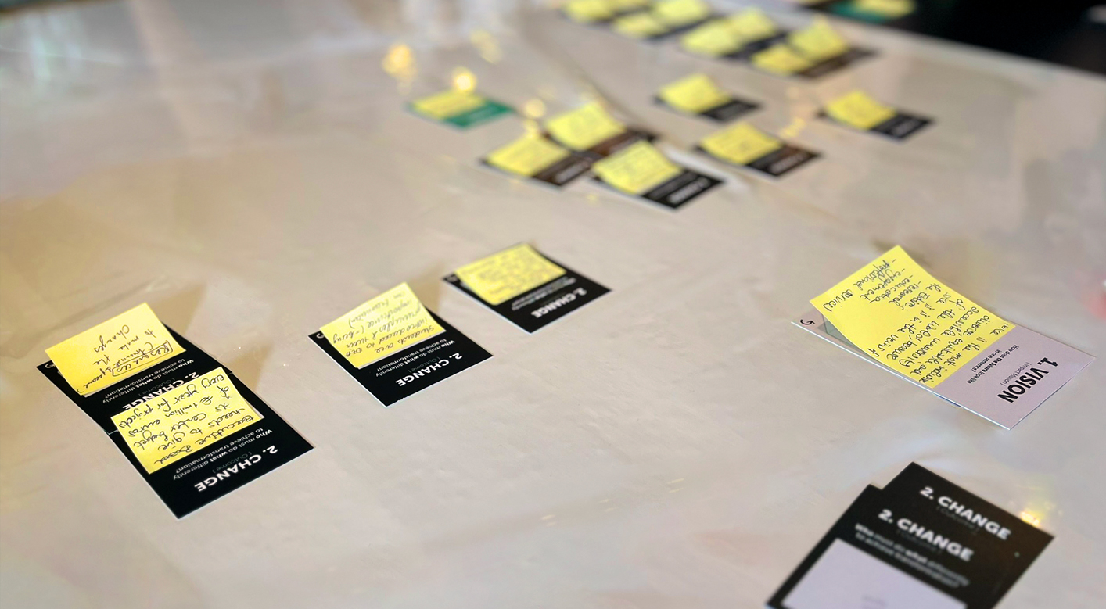
How was it?
What stood out for you?
Erasmus University Rotterdam | Evaluating Societal Impact
06 October 2025 | 16
Notes:
Note: Ask groups to summarize their Theory of Change (e.g. read out their joint Vision, and a change that they found important, an impact pathway, something that stood out.)

Slide 17
Today we…
Learned about Theory of Change
Built a (simplified) ToC
Any more questions?
Erasmus University Rotterdam | Evaluating Societal Impact
06 October 2025 | 17

Slide 18
Next steps
[What participants can expect after the session]
Erasmus University Rotterdam | Evaluating Societal Impact
06 October 2025 | 18

Slide 19





Contact
Name
Phone
E-mail
Location
Web address

