Slide 1
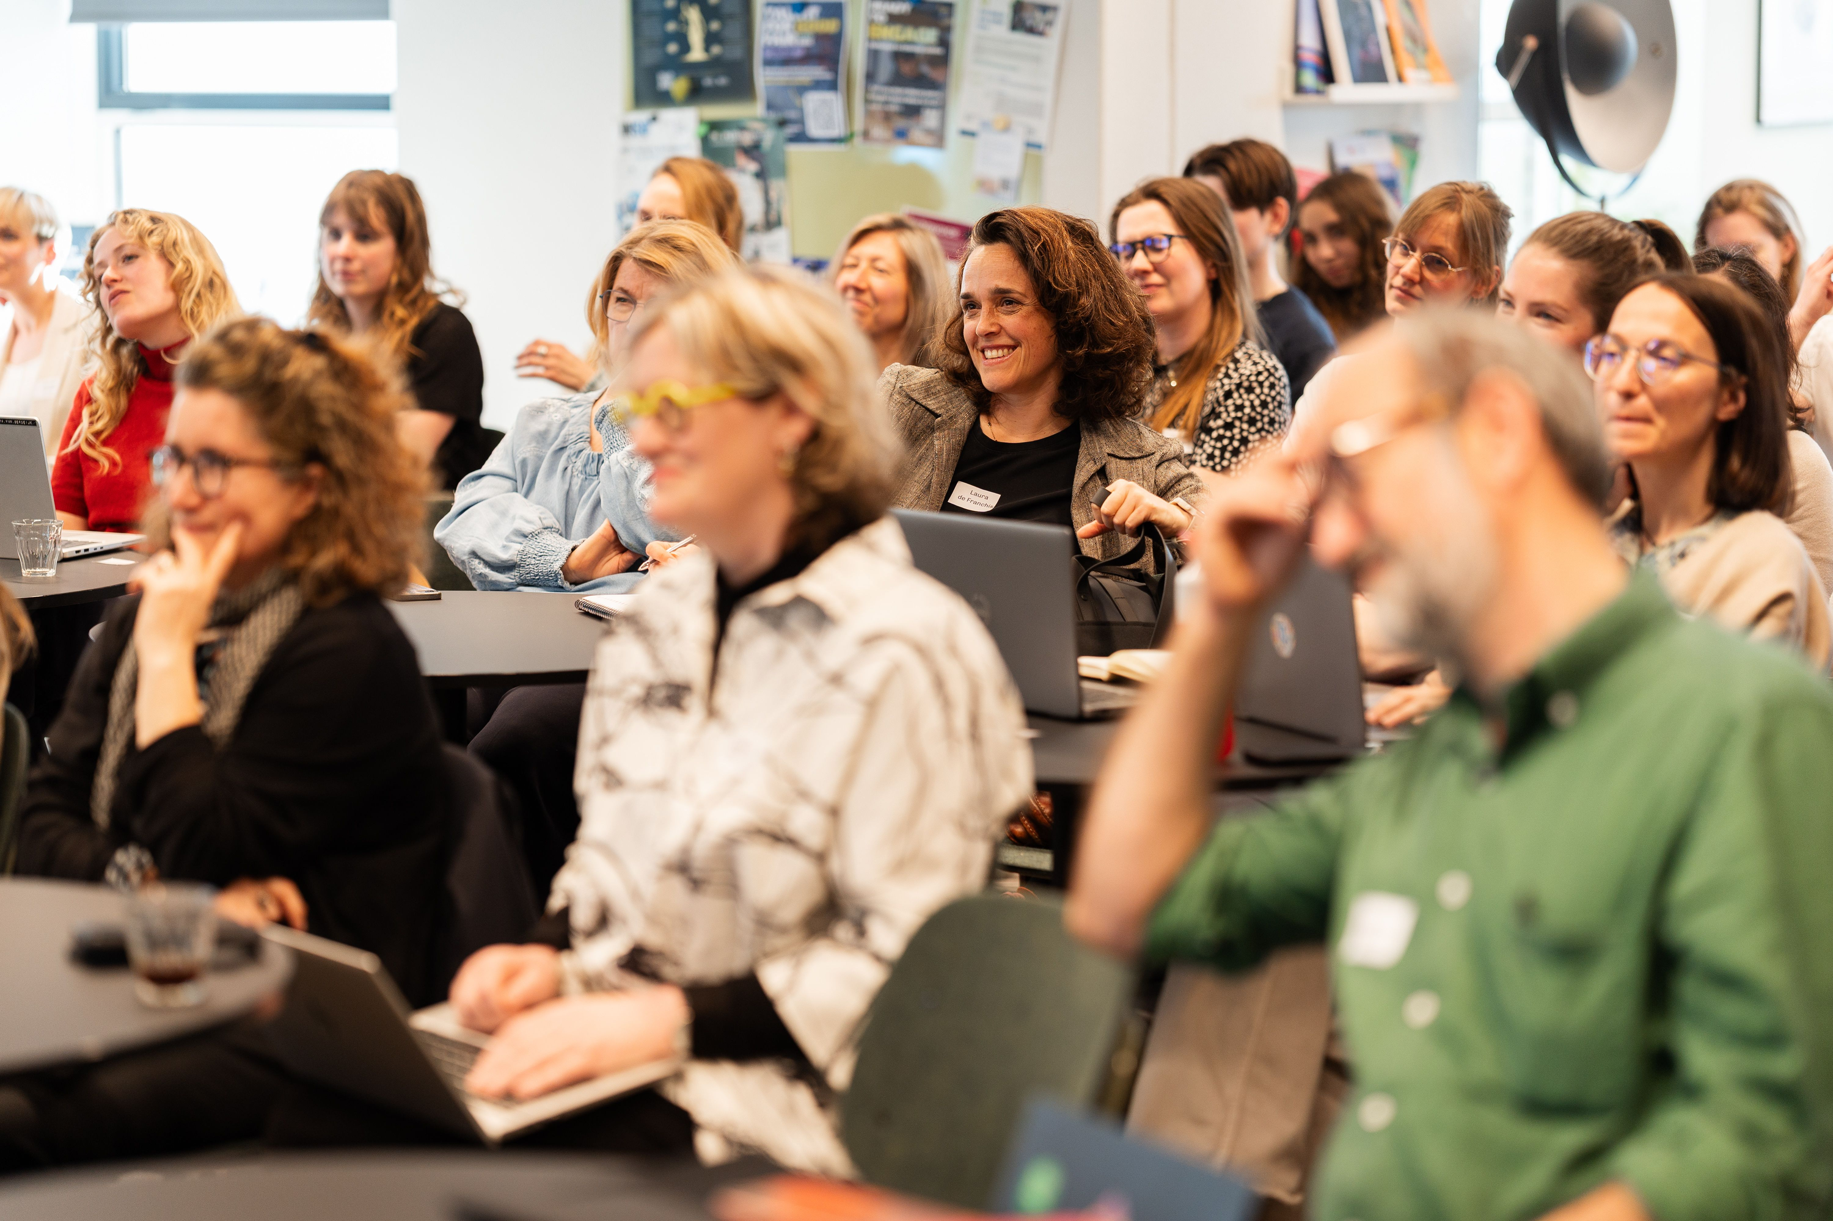




climate justice community
From TAFF (Santa Marta)
to Just Transition (COP 31)
and Beyond
June 16th 14:00 - 20:00
The Hague Humanity Hub

Slide 2

Programme
14:00 - 14:15
14:15 - 15:25
Welcome and Introduction
Panel Discussion
Contextualising Santa Marta (2026) for fossil fuel phase-out
Examining the three TAFF ‘Workstreams’
Reflections on the path(s) ahead
Prof. Elisa Morgera, UN Special Rapporteur on climate change
Panel Discussion
TAFF26 to TAFF 27, and TAFFs to COP 31 and beyond
Networking Drinks
15:30 - 16:30
17:15 - 17:35
17:35 - 18:45
18:45 - 20:00

Slide 3
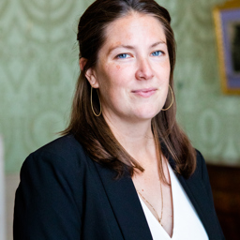
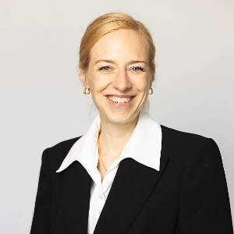
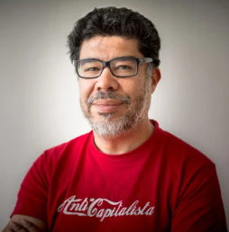
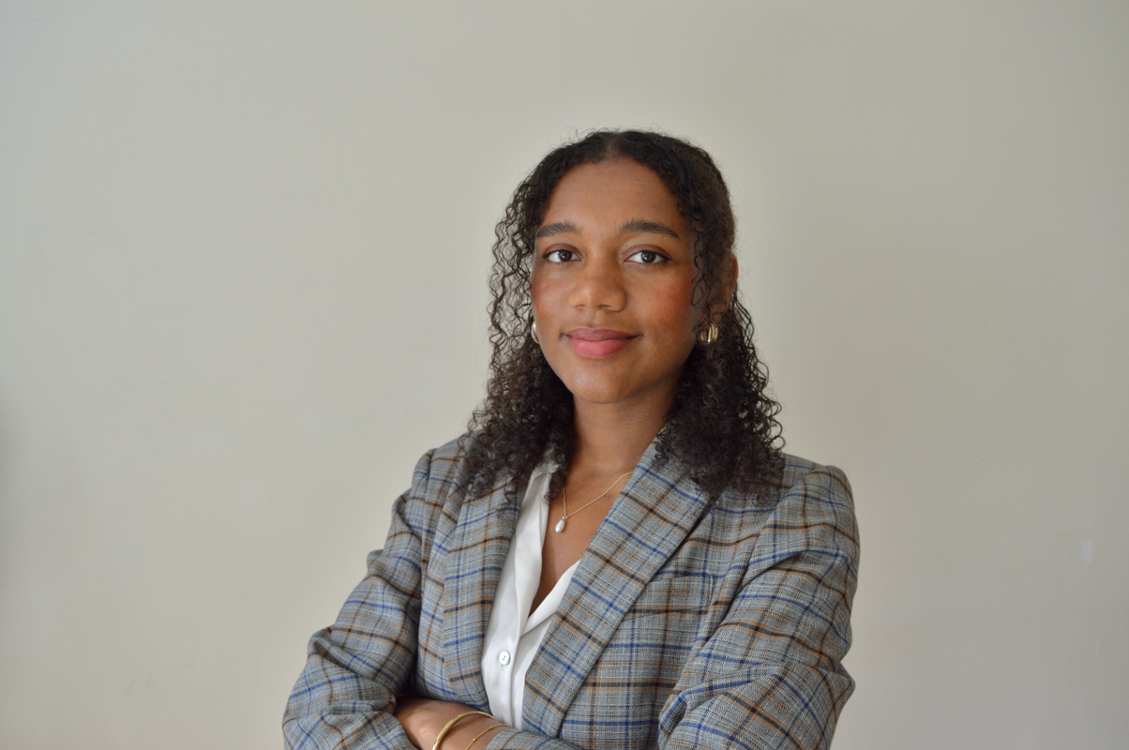
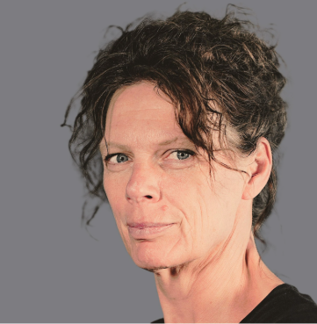
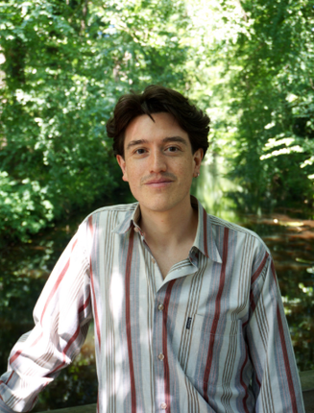

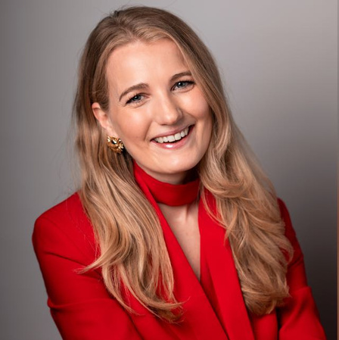
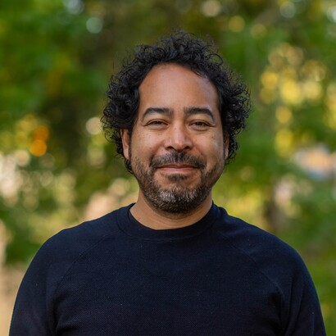
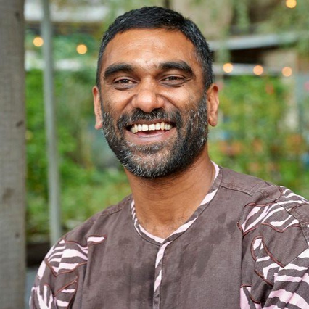
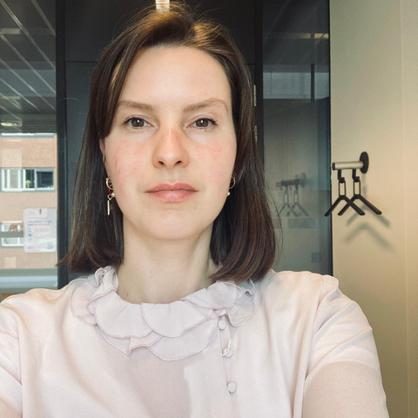
PANEL DISCUSSION
Reflecting on Santa Marta (TAFF 2026)
Dr. Stephanie Triefus
Dr. Margaretha Wewerinke-Singh
Dr. Daniel Chavez
Dimple Sokartara-Pamudji
Fernando Hernandez
Josephine Ris
T.M.C. Asser Instituut
University of Amsterdam
Transnational Institute & University of the Basque Region
Mondiaal FNV
Head of Trade & Investment Policy, Both ENDS
Senior policy officer Energy Saving, Ministry of Economic Affairs and Climate
]

Slide 4
Working Sessions
Co-creating inclusive transition roadmaps
  Facilitator: Dr. Stephanie Triefus (T.M.C Asser Instituut)
  Room: Maple 3rd floor
Towards a more effective, equitable and inclusive financial system to phase-out fossil fuels
  Facilitator: Dr. Siobhán Airey (Erasmus University Rotterdam)
  Room: Magnolia 3rd floor
Thinking inclusively about the producer-consumer alignment in TAFF [focusing on the trade/investment regimes, and the ‘energy sovereignty’ debate
  Facilitator: Prof Alessandra Arcuri (Erasmus University Rotterdam)
  Room: Baobab 3rd floor

Slide 5
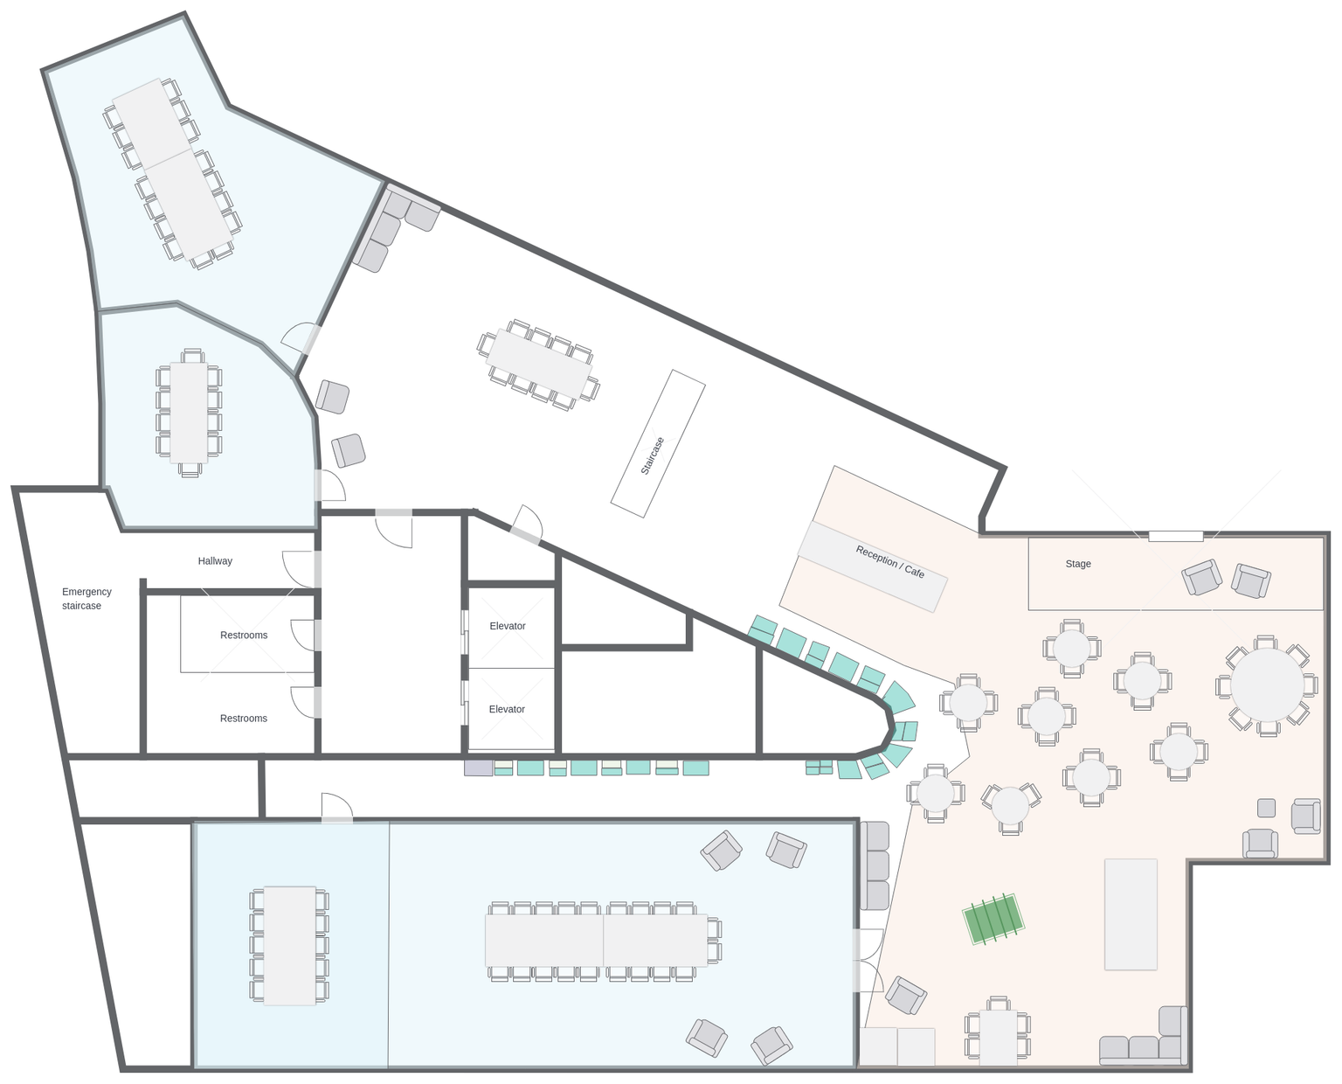
Map
Magnolia
Workstream 2
Boabab
Maple
Workstream 3
Workstream 1

Slide 6
climate justice community
From TAFF (Santa Marta)
to Just Transition (COP 31)
and Beyond
June 16th 17:00 - 20:00
The Hague Humanity Hub

Slide 7
Programme
17:15 - 17:25
17:25 - 17:35
17:35 - 18:45
Feedback from the TAFF Workstreams
Reflections on the path(s) ahead
Prof. Elisa Morgera, UN Special Rapporteur on climate change
Panel Discussion: TAFF26 to TAFF 27, and TAFFs to COP 31 and beyond
Prof. Lorenzo Pellegrini, Erasmus University
Yağız Eren Abanus, Center for Spatial Justice
Sjoukje van Oosterhout, Progressief Nederland
Prof. Alessandra Arcuri, Erasmus University
Networking Drinks
18:45 - 20:00

Slide 8
Working Sessions
Co-creating inclusive transition roadmaps
  Facilitator: Dr. Stephanie Triefus (T.M.C Asser Instituut)
Towards a more effective, equitable and inclusive financial system to phase-out fossil fuels
  Facilitator: Dr. Siobhán Airey (Erasmus University Rotterdam)
Thinking inclusively about the producer-consumer alignment in TAFF [focusing on the trade/investment regimes, and the ‘energy sovereignty’ debate
  Facilitator: Prof Alessandra Arcuri (Erasmus University Rotterdam)

Slide 9

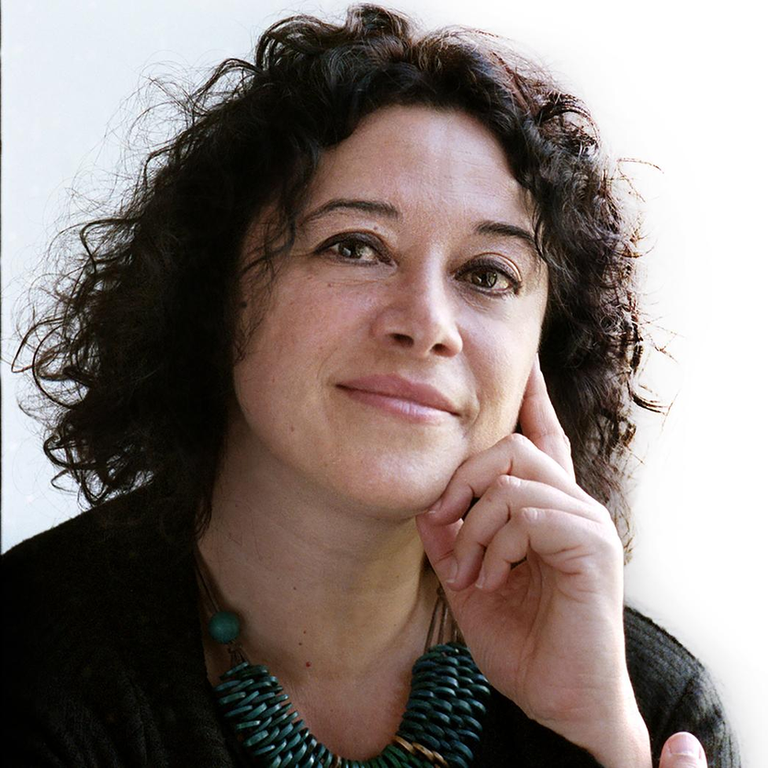
KEYNOTE ADDRESS
Prof. Elisa Morgera
UN Special Rapporteur on Climate Change

Slide 10
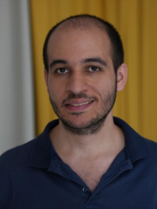
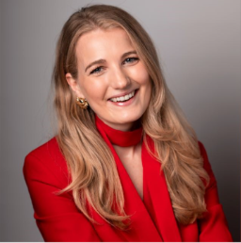
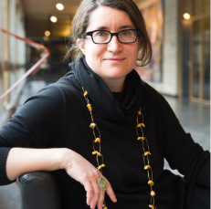

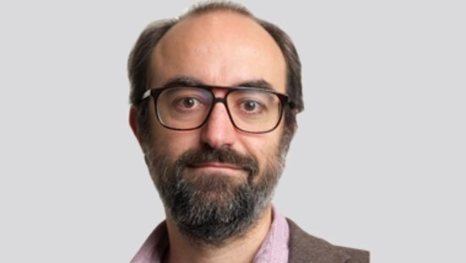
PANEL DISCUSSION
TAFF26 to TAFF 27, and TAFFs to COP 31 and Beyond
Prof. Lorenzo Pellegrini
Yağız Eren Abanus
Sjoukje van Oosterhout
Prof. Alessandra Arcuri
Dr. Siobhán Airey
Erasmus University
Erasmus University
Center for Spatial Justice
Progressief Nederland
Erasmus University
]

Slide 11
What Happens Next?
✓ Share your feedback on today's event
✓ Receive our Manifesto & Agenda Report
✓ Stay connected and engaged
Contact us: climate@humanityhub.org

Slide 12
THANK YOU!
climate@humanityhub.org
Thank you to the Netherlands Network on Human Rights, and EU SHIFT COST Action for their support of this event

